Slide 1
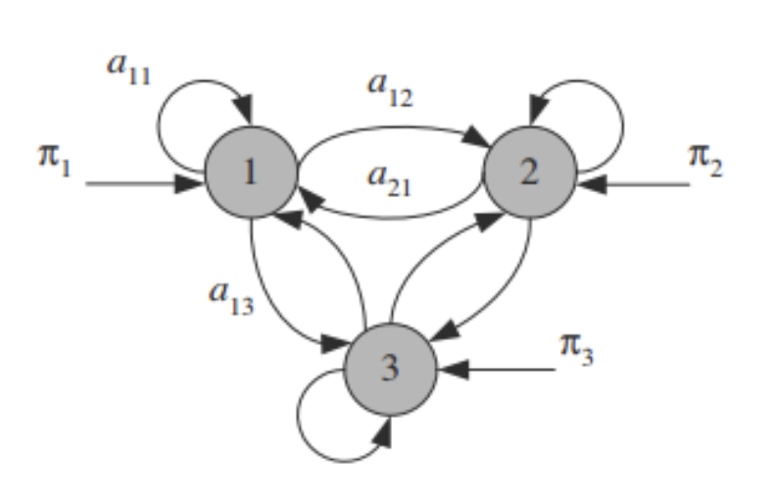
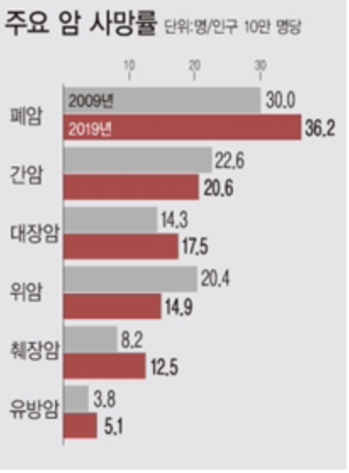
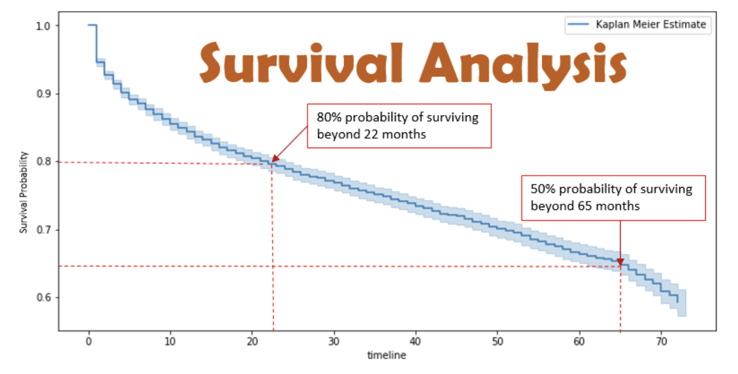
Development of prediction and survival
statistical models for liver cancer
Liver Cancer
Cause : HBV ,HCV, Cirrhosis, Hepatitis, Diabete Mellitus, Alcohol, Fatty Liver, etc...
Use the Markov model to estimate the transition probability through factors that affect cancer incidence

